Slide 1

Senior Design I
Litter Collection Robot
1
Advisors
Dr. Dongchul Kim
Dr. Sanjeev Kumar
Members
Diego Garcia
Richard Jones
Sergio Montoya

Slide 2
Table of Contents
2
Purpose
Scope of Work
Structure
Electrical Engineering
Computer Engineering

Slide 3
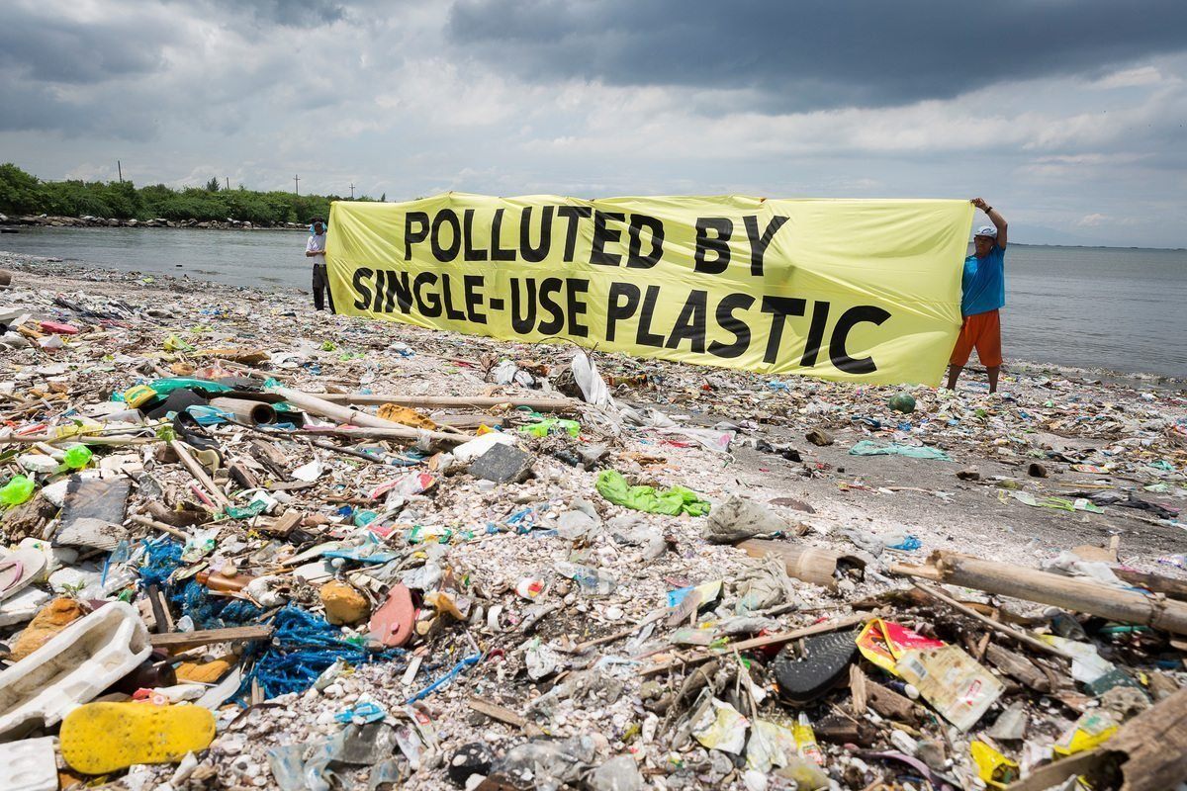
Purpose
3
The influx of global mass production and lack of solutions to proper waste management in some areas has led to widespread litter contamination.
Current remedies to this issue have been volunteer and community based efforts.
We decided instead to make a machine which can help resolve the issue that production machinery has been used to propagate.

Slide 4
Scope of Work
4
The goal of our project is to design a robot that can navigate natural environments, identify litter, and proceed to collect it.
To achieve this our team split the project into different sections:
Physical structure of robot
Electrical hardware components
Software design components

Slide 5
Structure
5

Slide 6
3D Printed Components
6
Robot Frame
Mounting base for Rover 5
Gears for pickup mechanism
Closing litter sled
Mounting
Webcam & Servo Mount
Ultrasonic Sensor Mount (Underside)

Slide 7
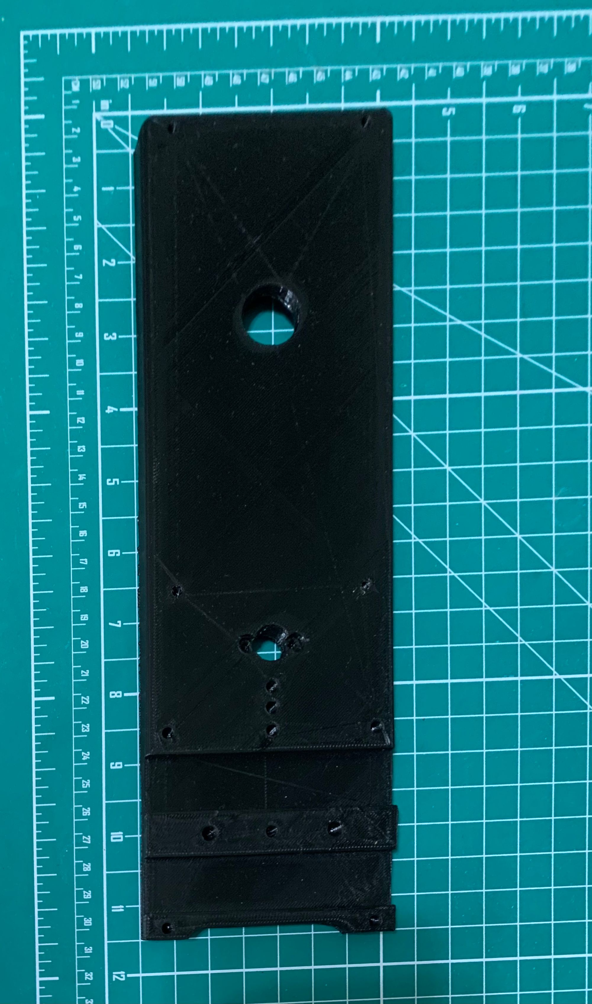
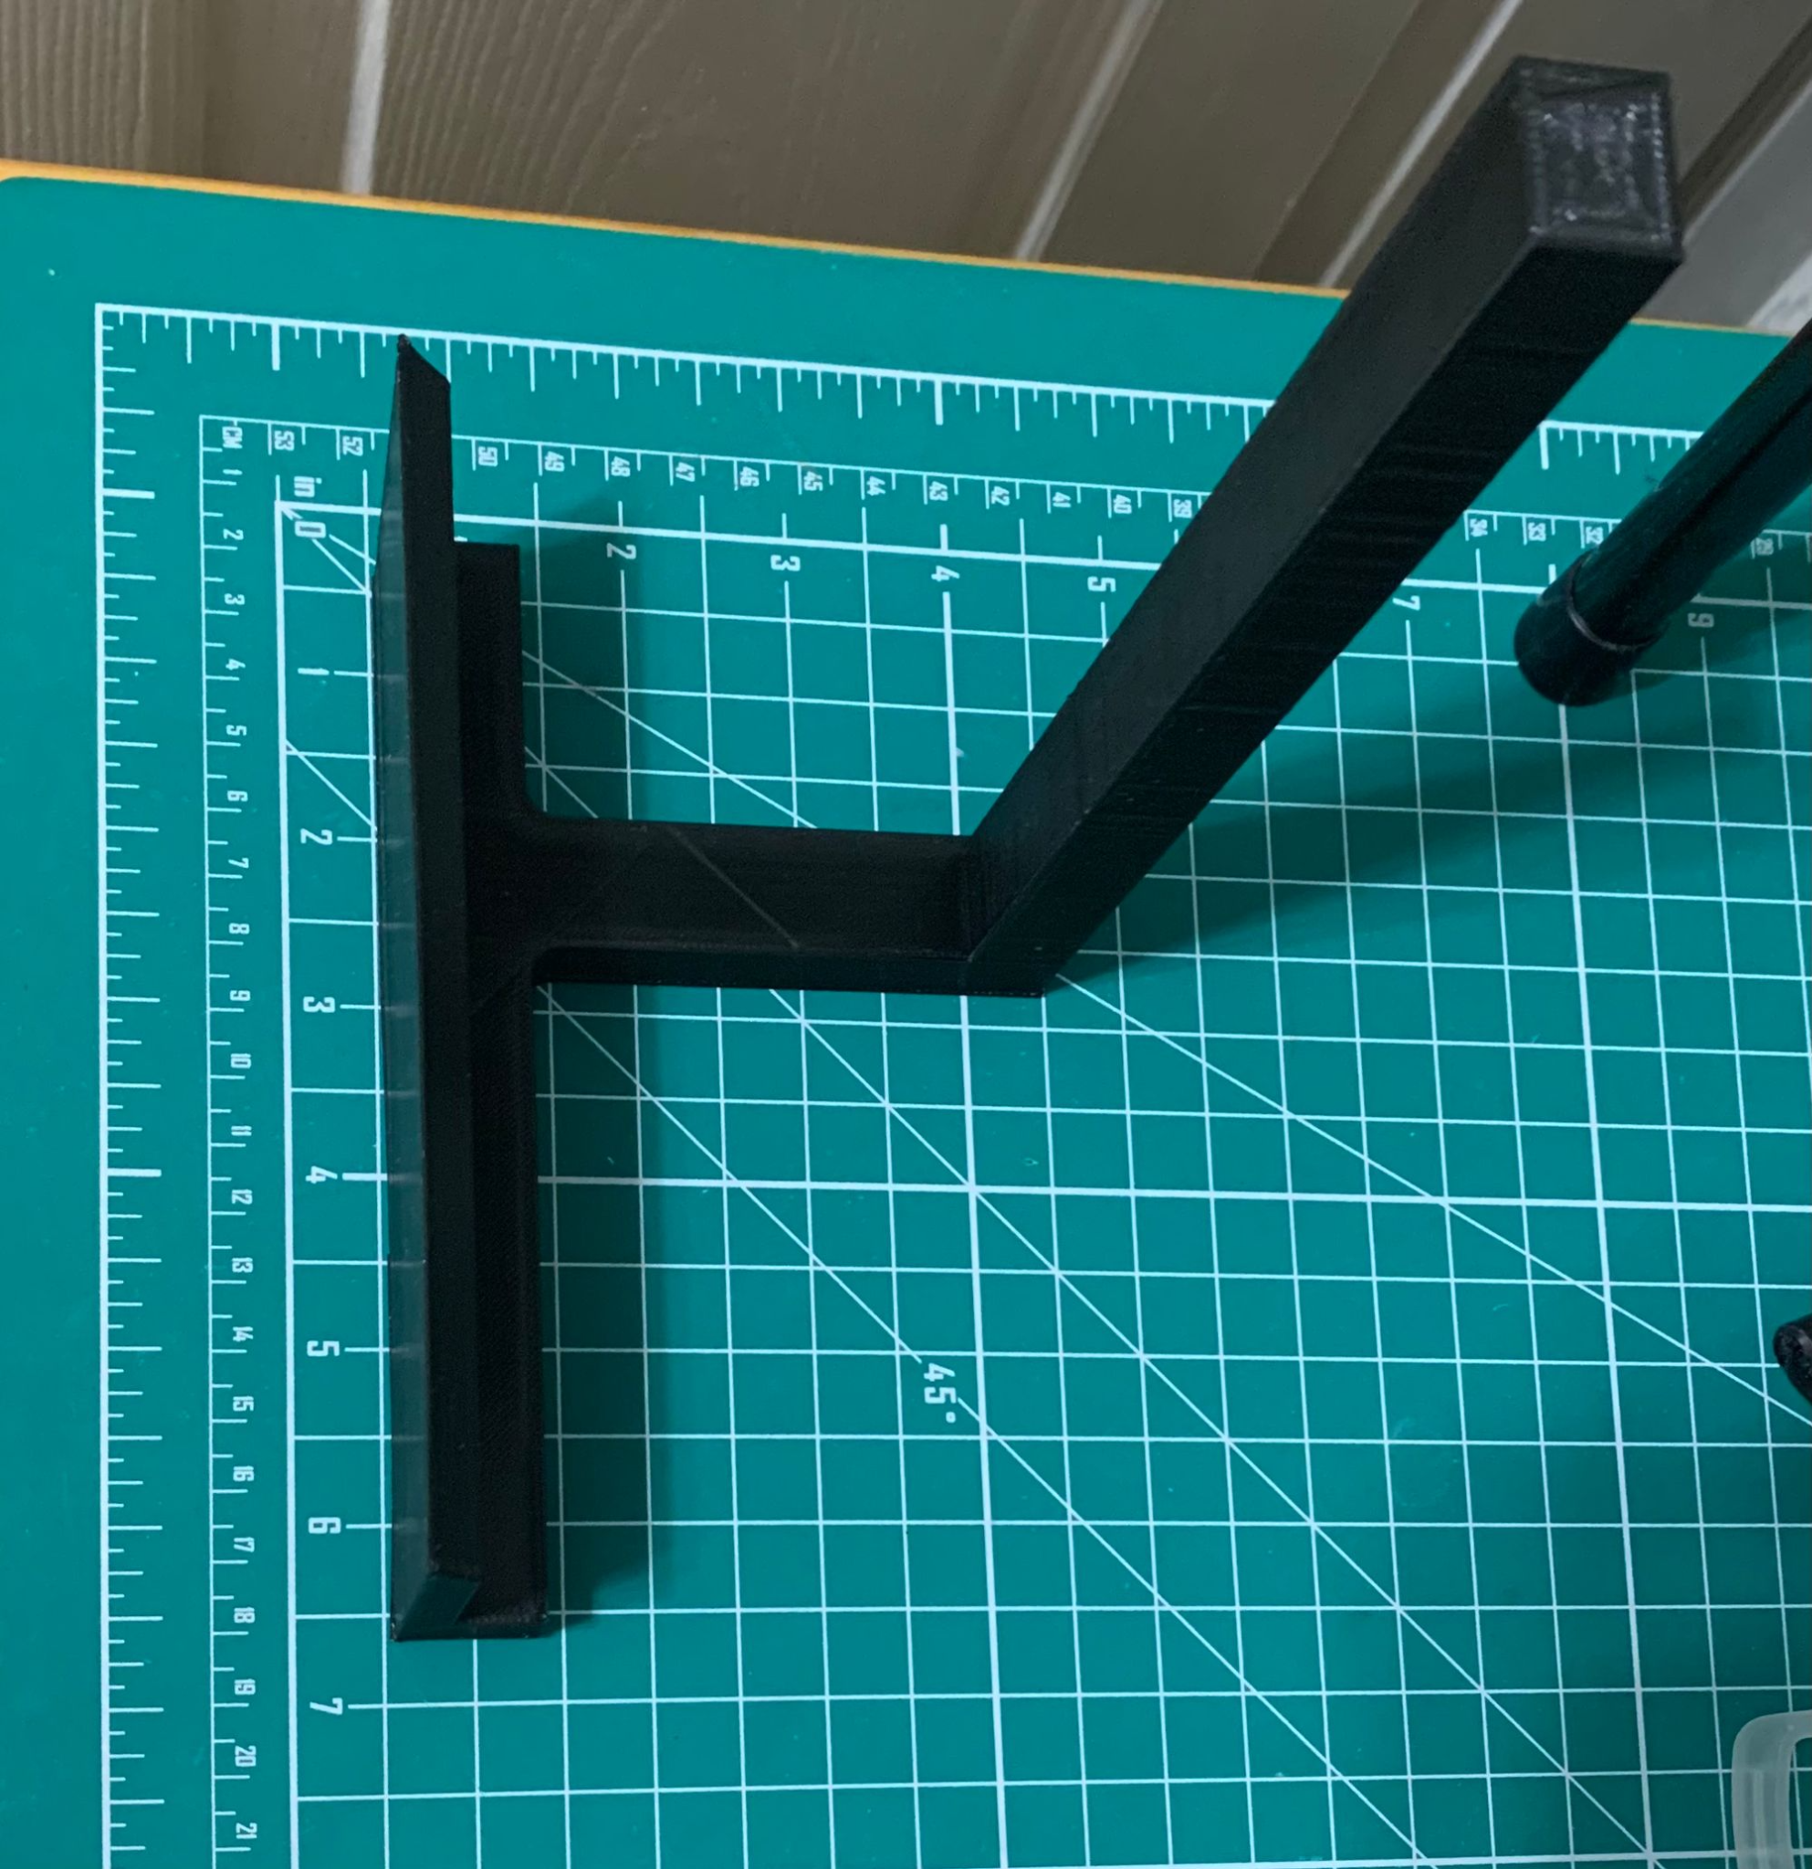
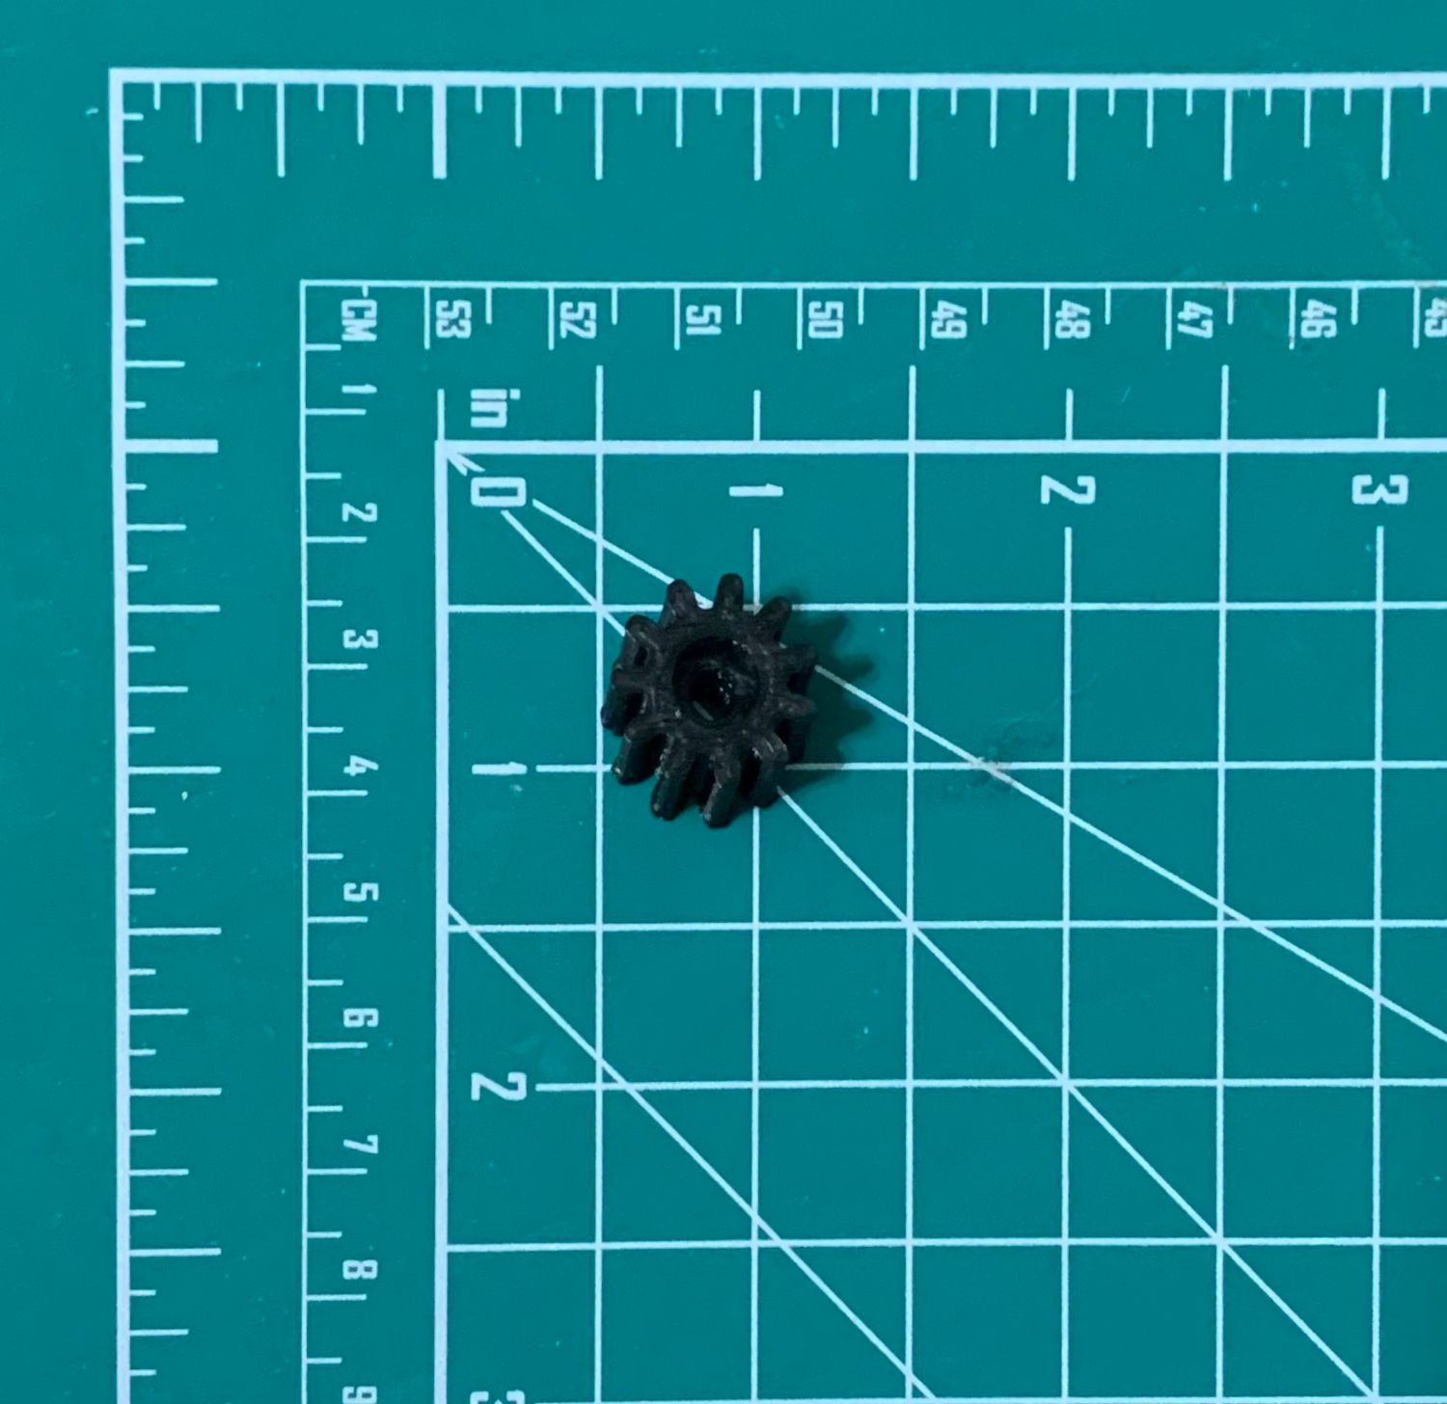
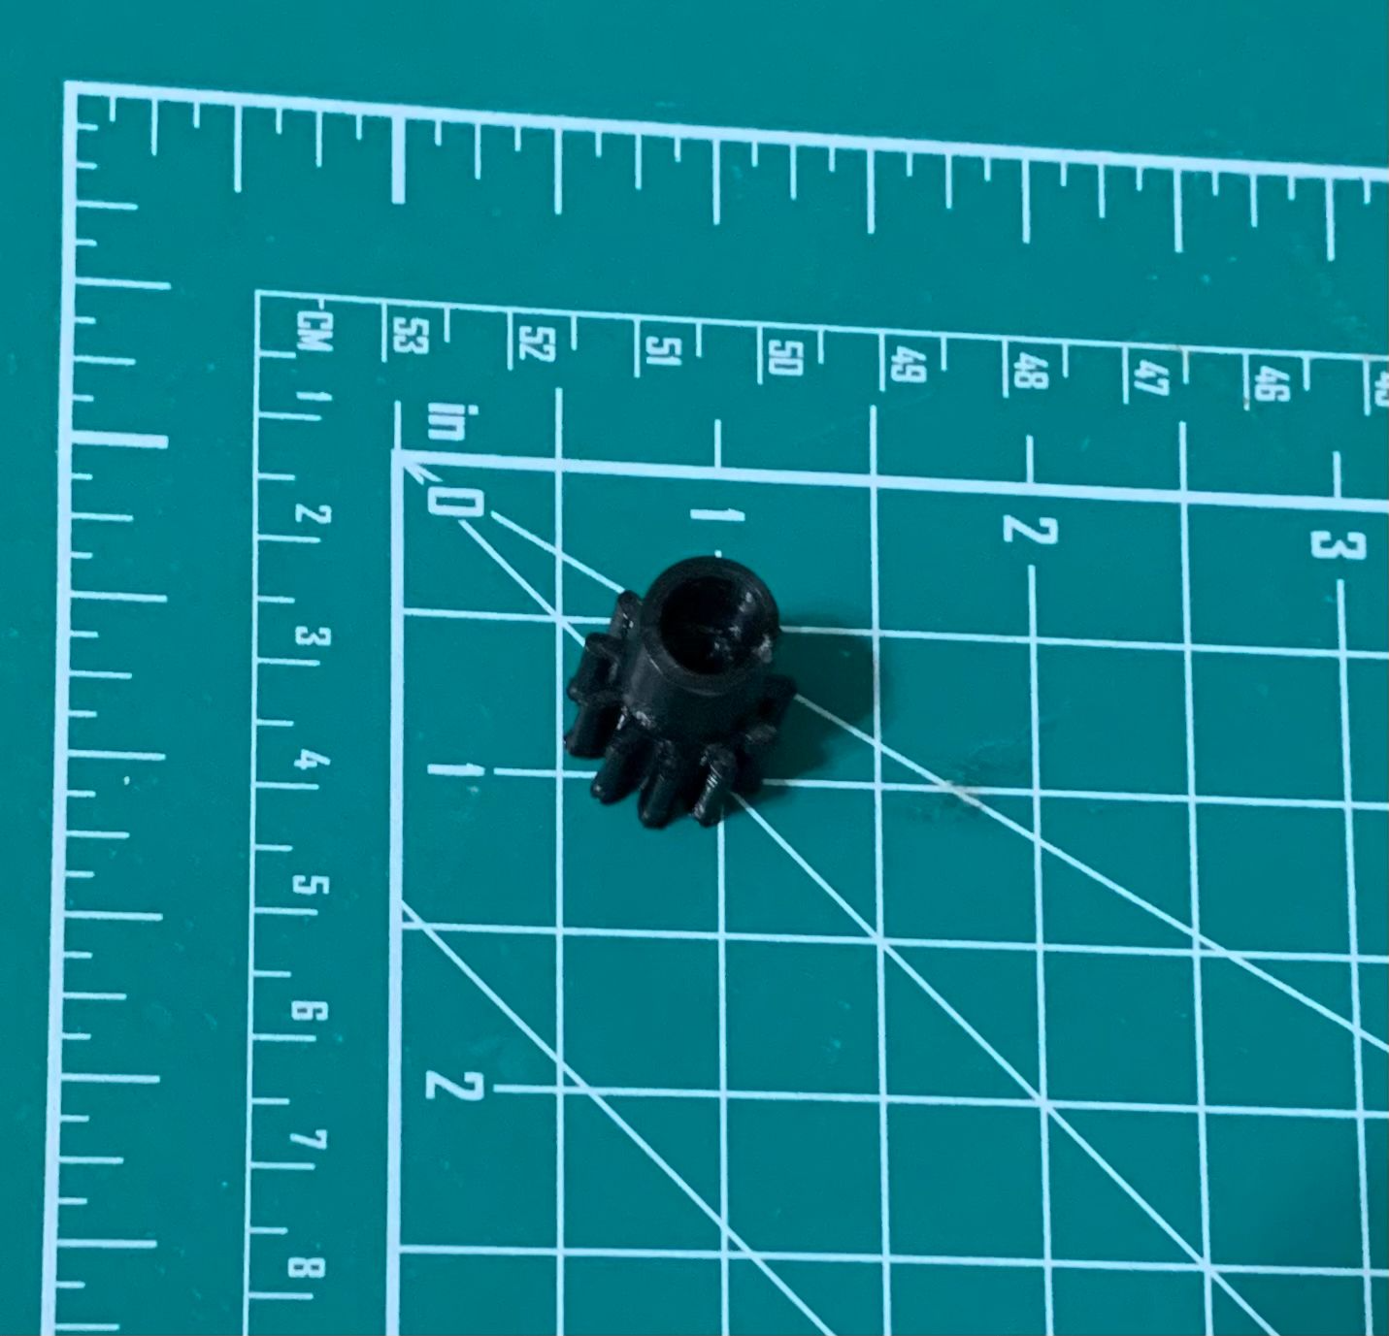
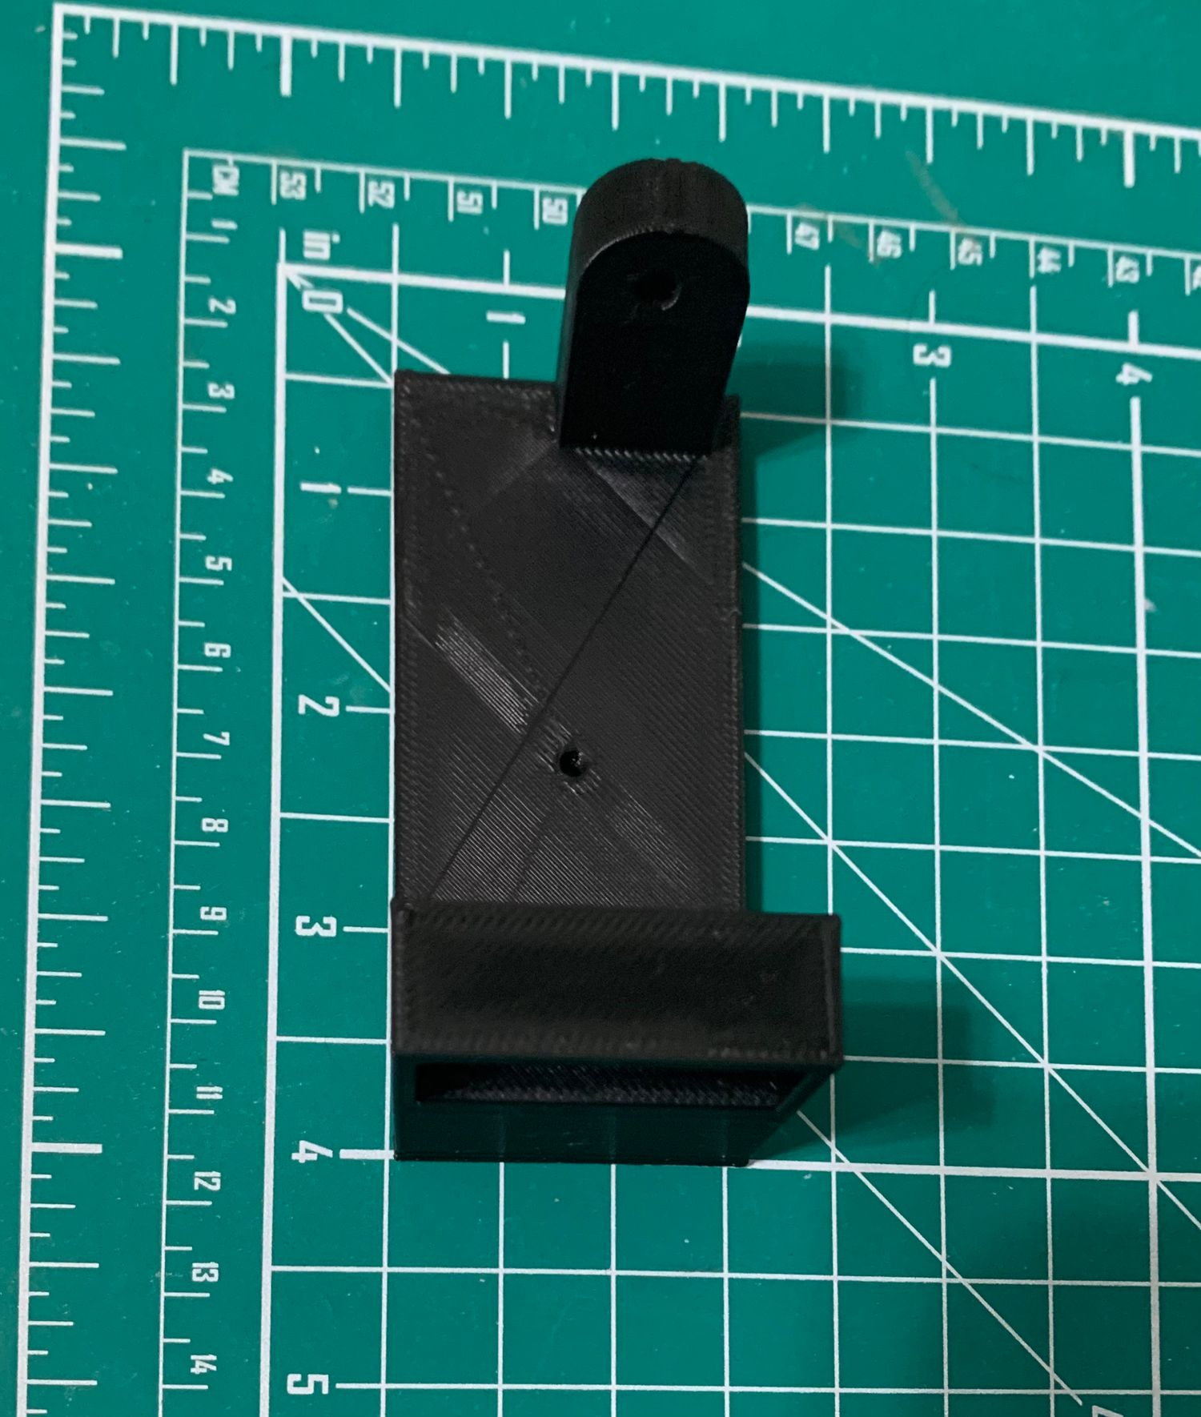
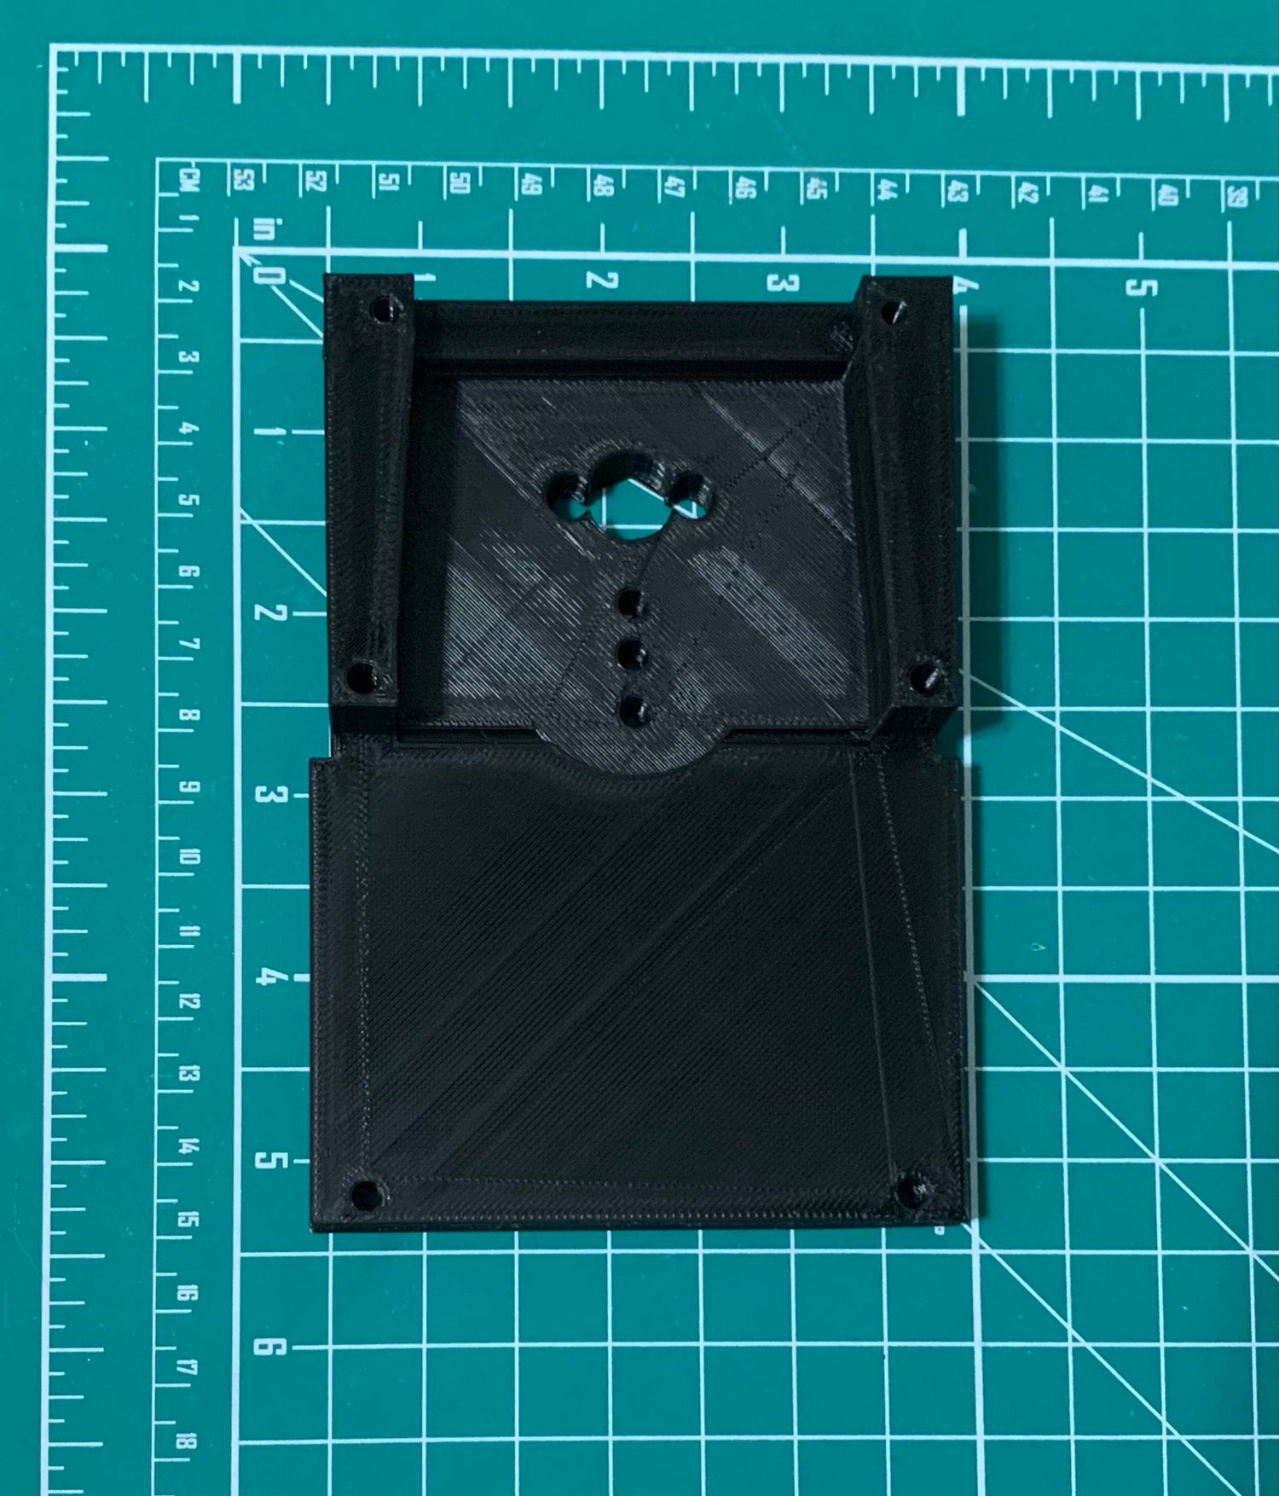
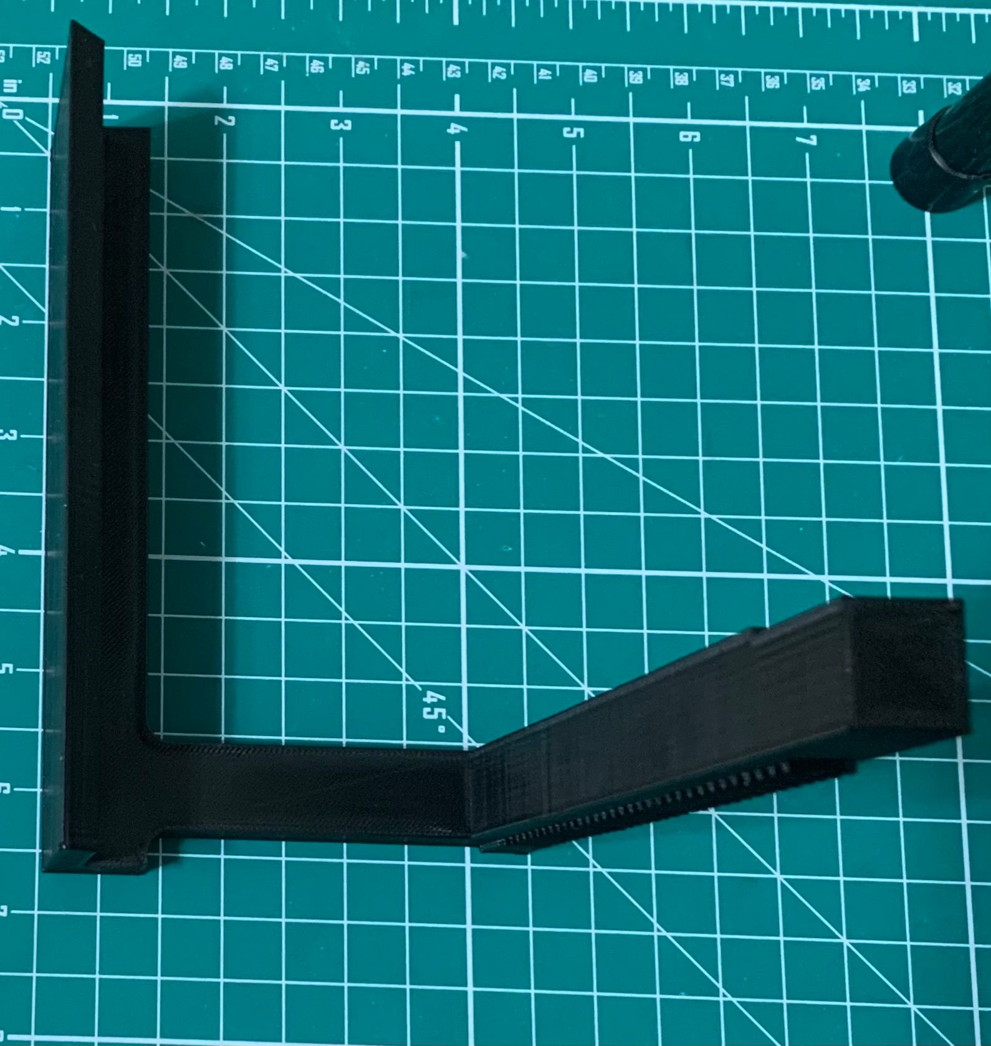
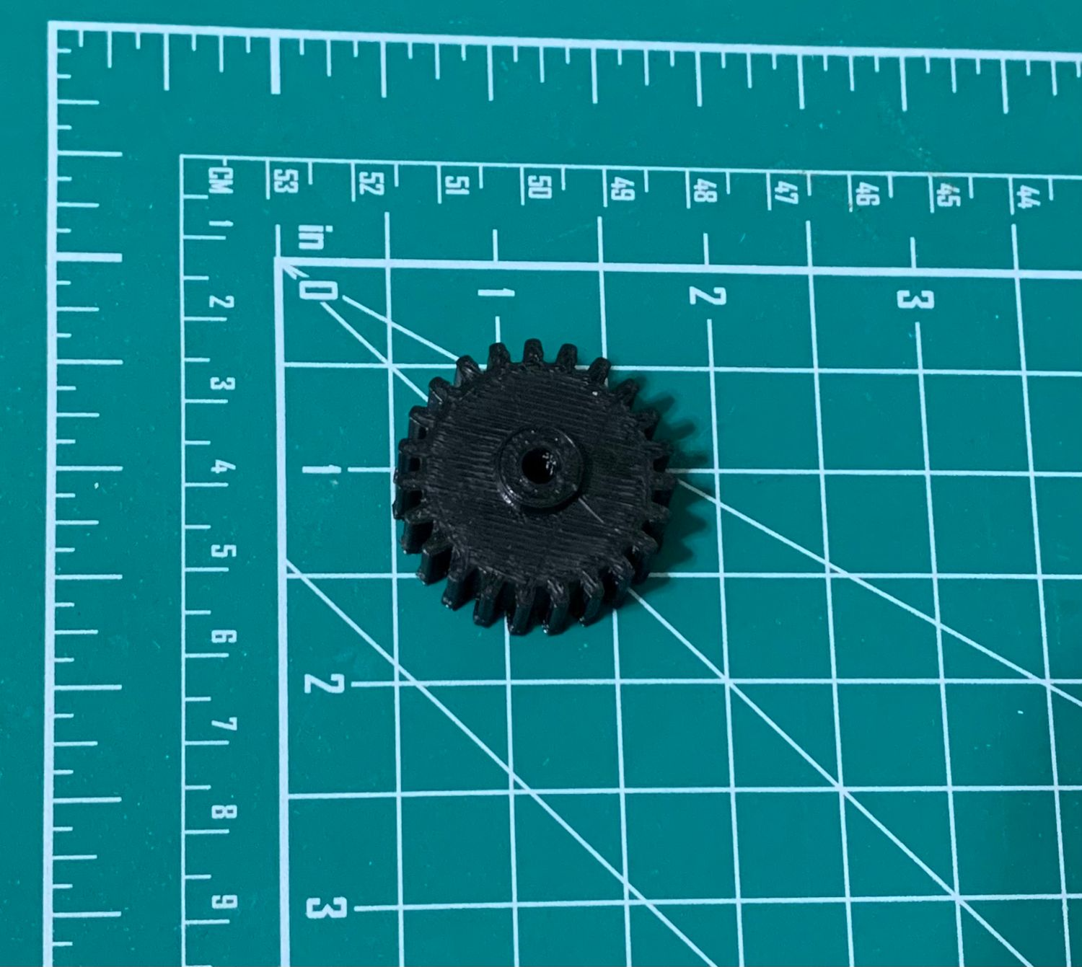
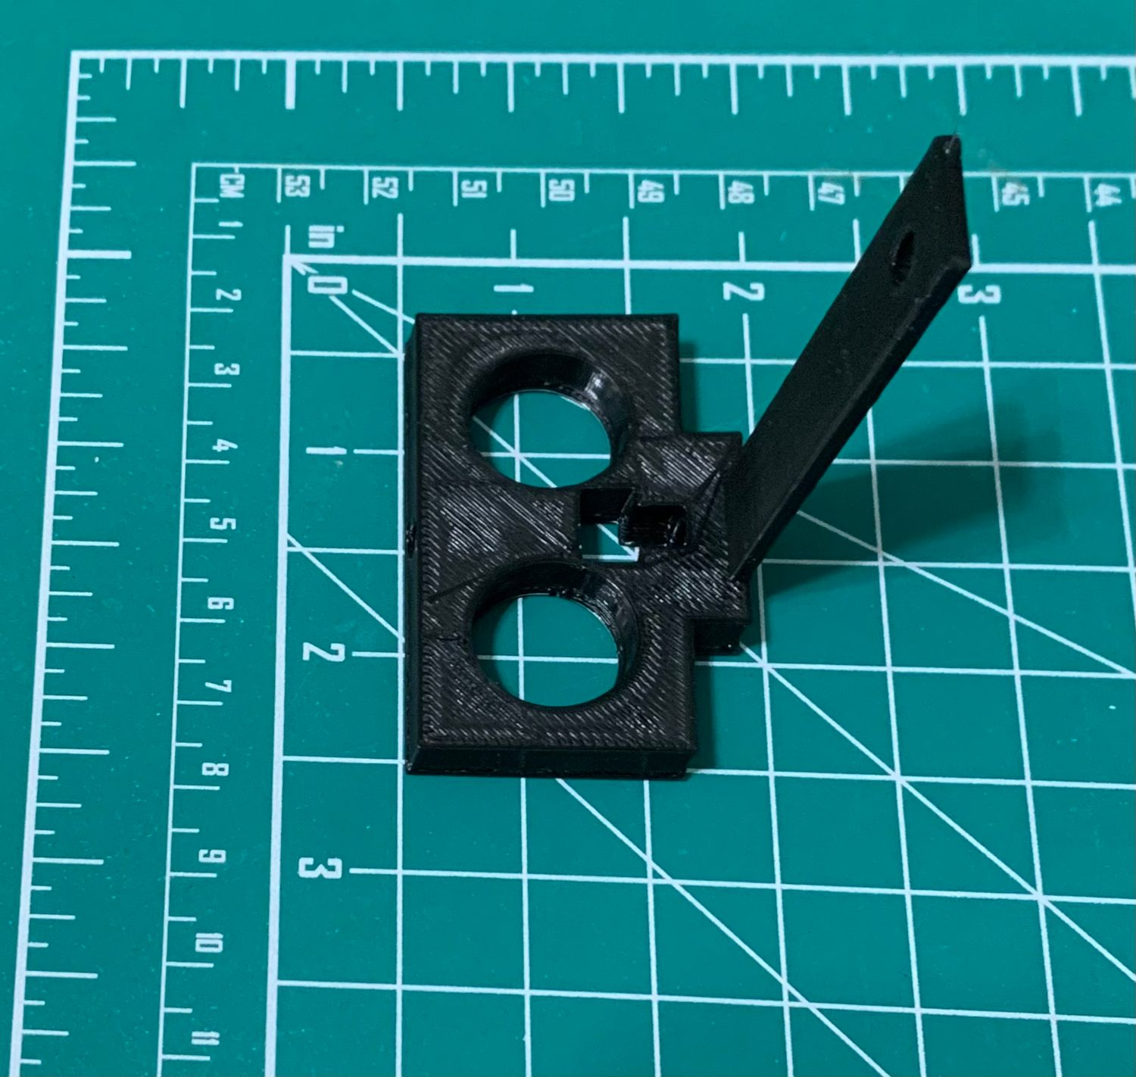
3D Printed Components
7

Slide 8
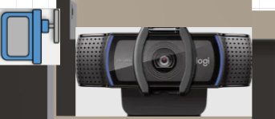
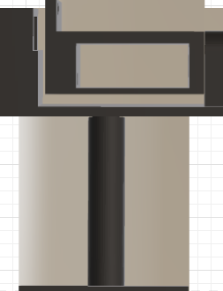
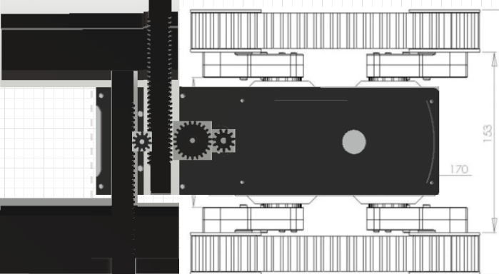
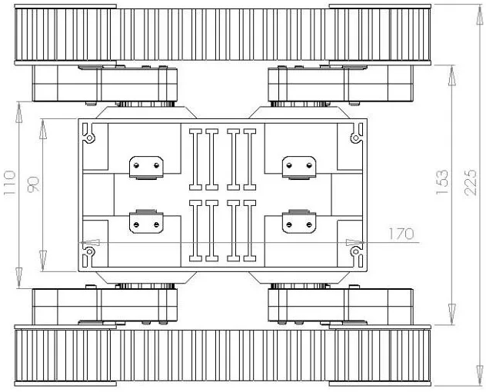


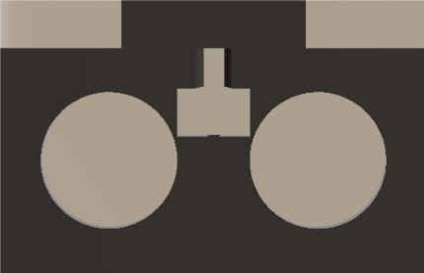
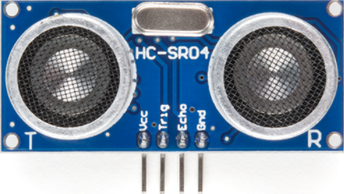
Structural Design Diagram
8

Slide 9
Electrical Engineering
9

Slide 10
Hardware
10
Ground Transportation Subsystem
DC Motors & Motor Drivers
Power Management
Lithium Polymer rechargeable cells
Battery Management System (BMS)

Slide 11
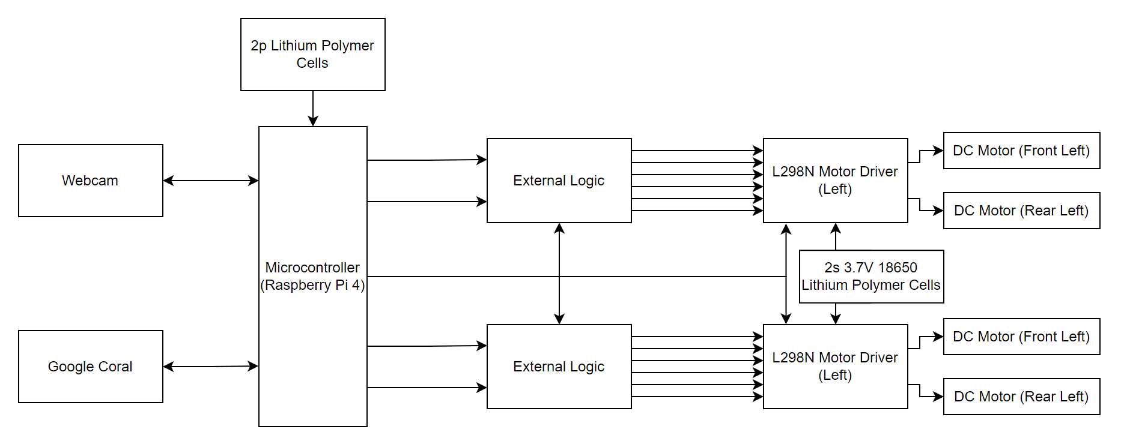
Hardware Block Diagram
10

Slide 12
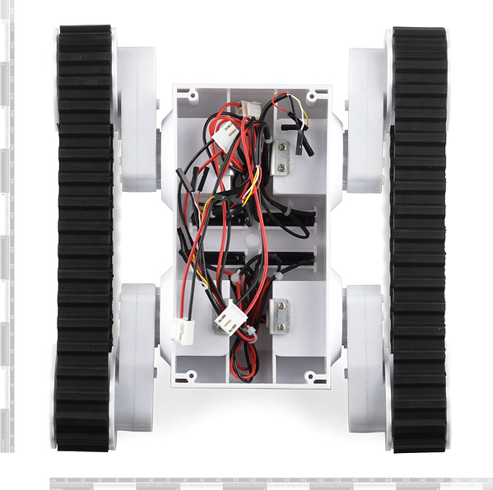
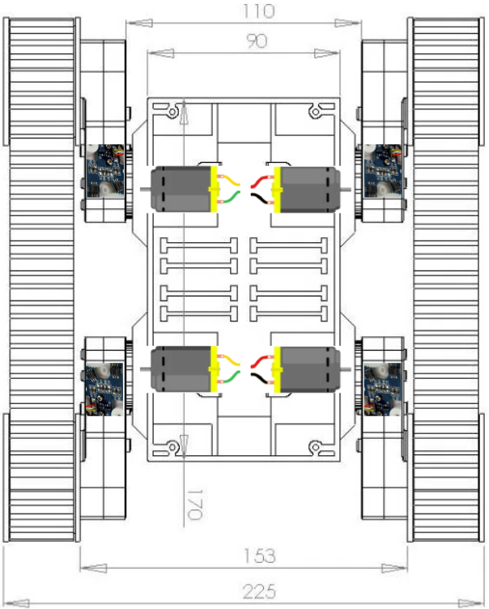
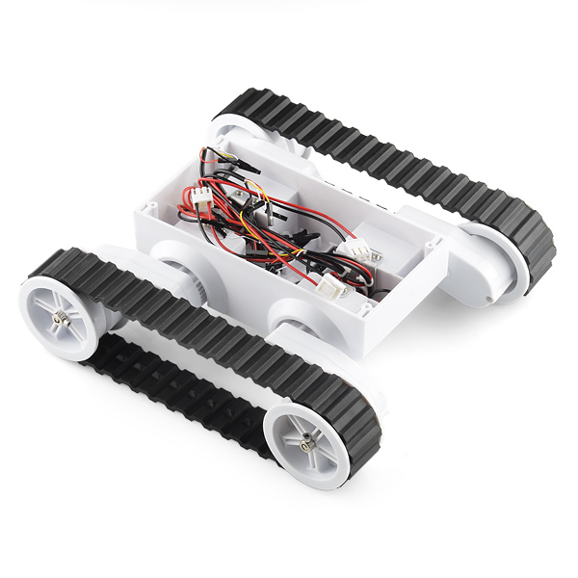
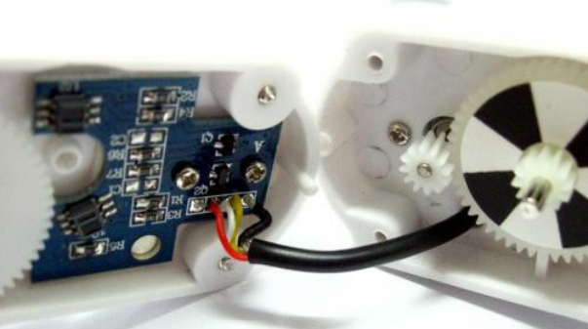
Rover 5 Platform
11
Components:
4 independent 7.2V DC motors
4 quadrature hall-effect encoders
4 gear boxes
2 rubber tank treads

Slide 13
Computer Engineering
12

Slide 14
Software
13
Machine Learning
Object detection and Computer Vision
Trash Annotations in Context (TACO) dataset
Google Coral USB Accelerator
Guidance, Navigation, and Control (GNC)
Motor controller functionality
Navigation based on webcam identification
Ground Transportation Subsystem
Encoder Logic
If/Else decisions

Slide 15
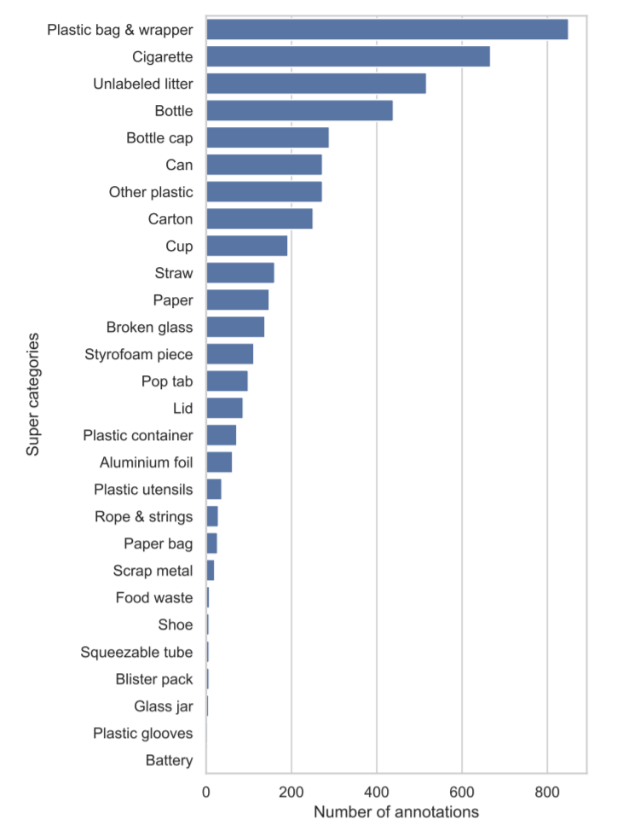
Machine Learning Model: Data
14
Data
Trash Annotated in Context (TACO) dataset for initial data
TACO contains images of waste in various environments
Categories
TACO includes many categories of litter, shown are the top categories litter falls into.
Preprocessing
Images feed into the model are original size, annotations are in Common Objects in Context (COCO) format, transformed into AutoML for EdgeTPU.

Slide 16
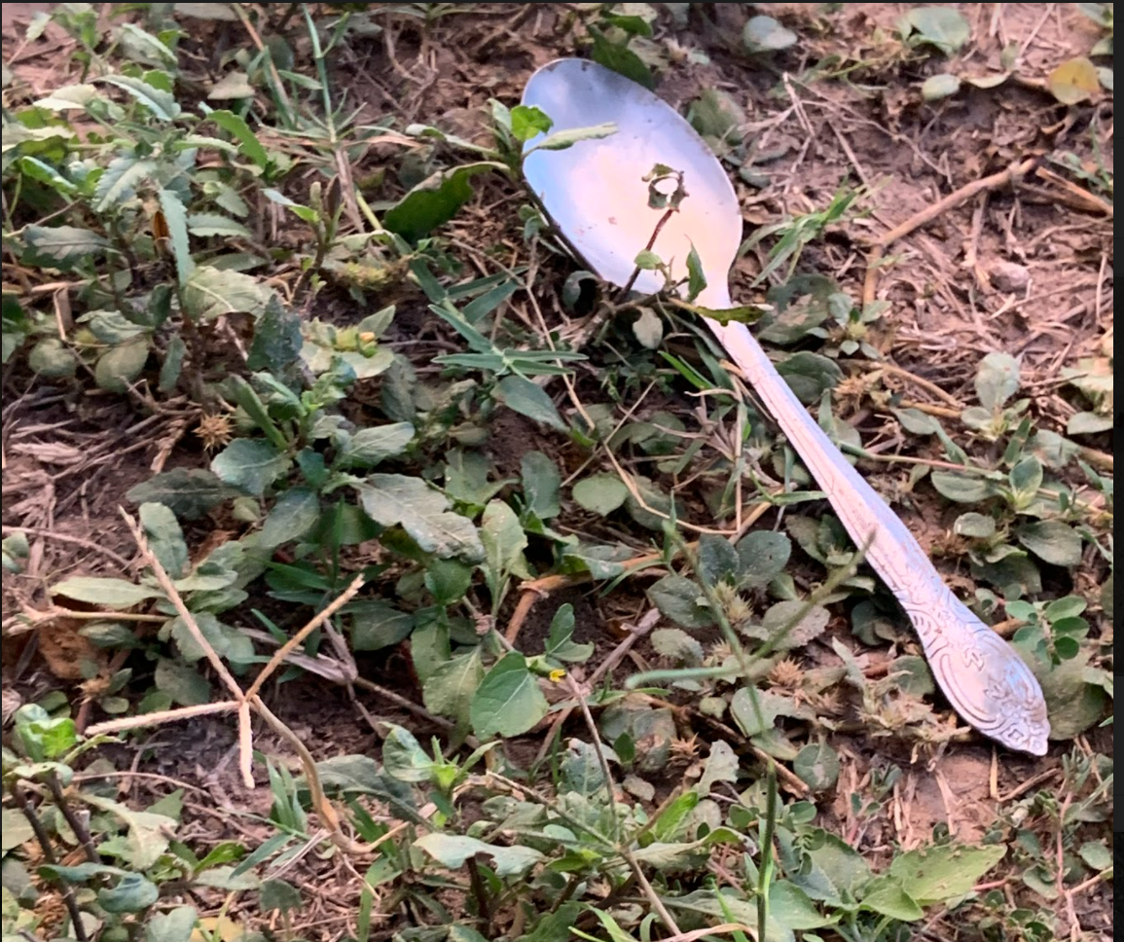
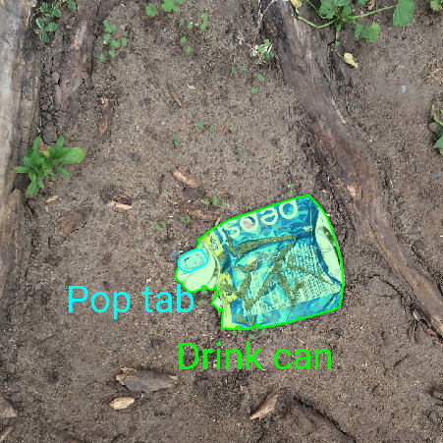
Machine Learning Model: Data
15
Dataset size
About 1500 TACO images
Categories underrepresented
Manual retraining of model to include new images to train model on underrepresented categories or objects.
Meaning, expandability or adjustment of model for different tasks.

Slide 17
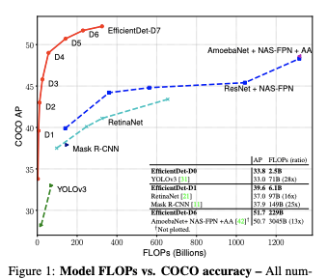
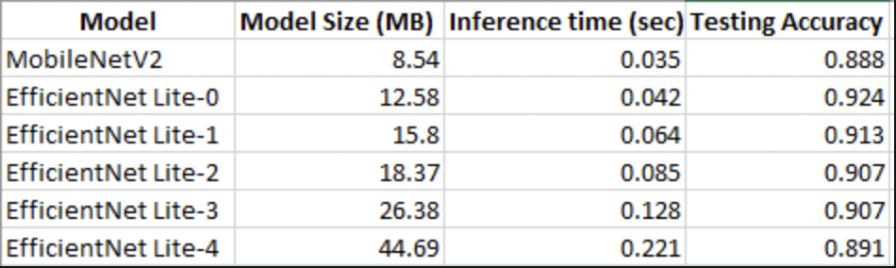
Machine Learning Model: EfficientDet
16
Our model utilizes EfficientDet-Lite architecture. Introduced late 2019, it outperforms competition and excels in speed and accuracy.
EfficientDet-Lite outclasses the commonly used MobileNet architecture.

Slide 18
Machine Learning Model: Training
17
(*) = Current model
Version | No. Epochs | Batch Size | Results
V1 | 25 | 12 | Trained on 200 Images
V2 | 25 | 12 | Trained on full dataset (1500 images)
V3 | 50 | 32 | Compilation Failed
V4 | 50 | 32 | Trained on Full Dataset
V5* | 50 | 32 | Increased categories from 28 -> 86
V6 | 50 | 32 | Untested (using EfficentDet-lite1)
Source
https://colab.research.google.com/drive/1ScW9TpiABhL5n6c7DL29qXc-dLeB5PzE#scrollTo=kwlYdTcg63xy

Slide 19
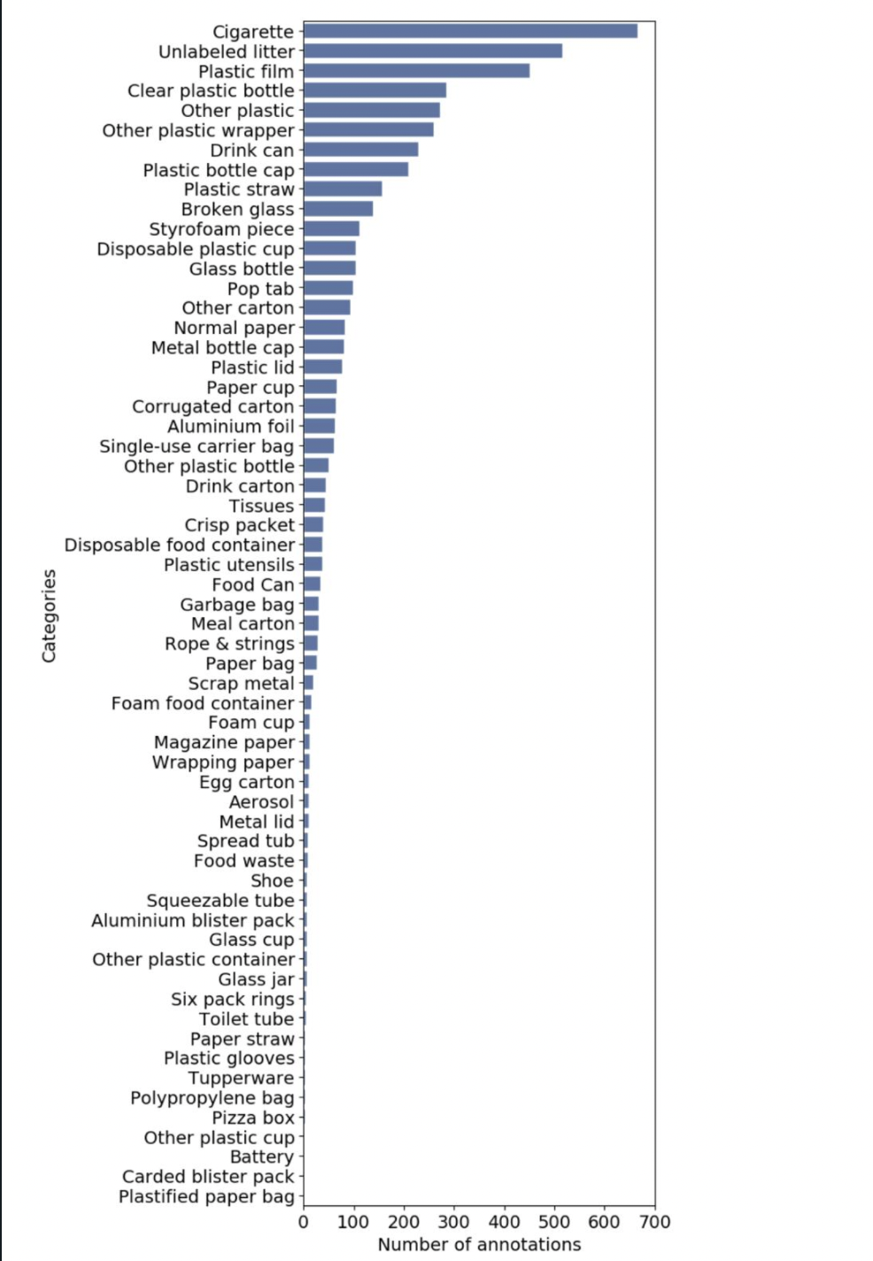
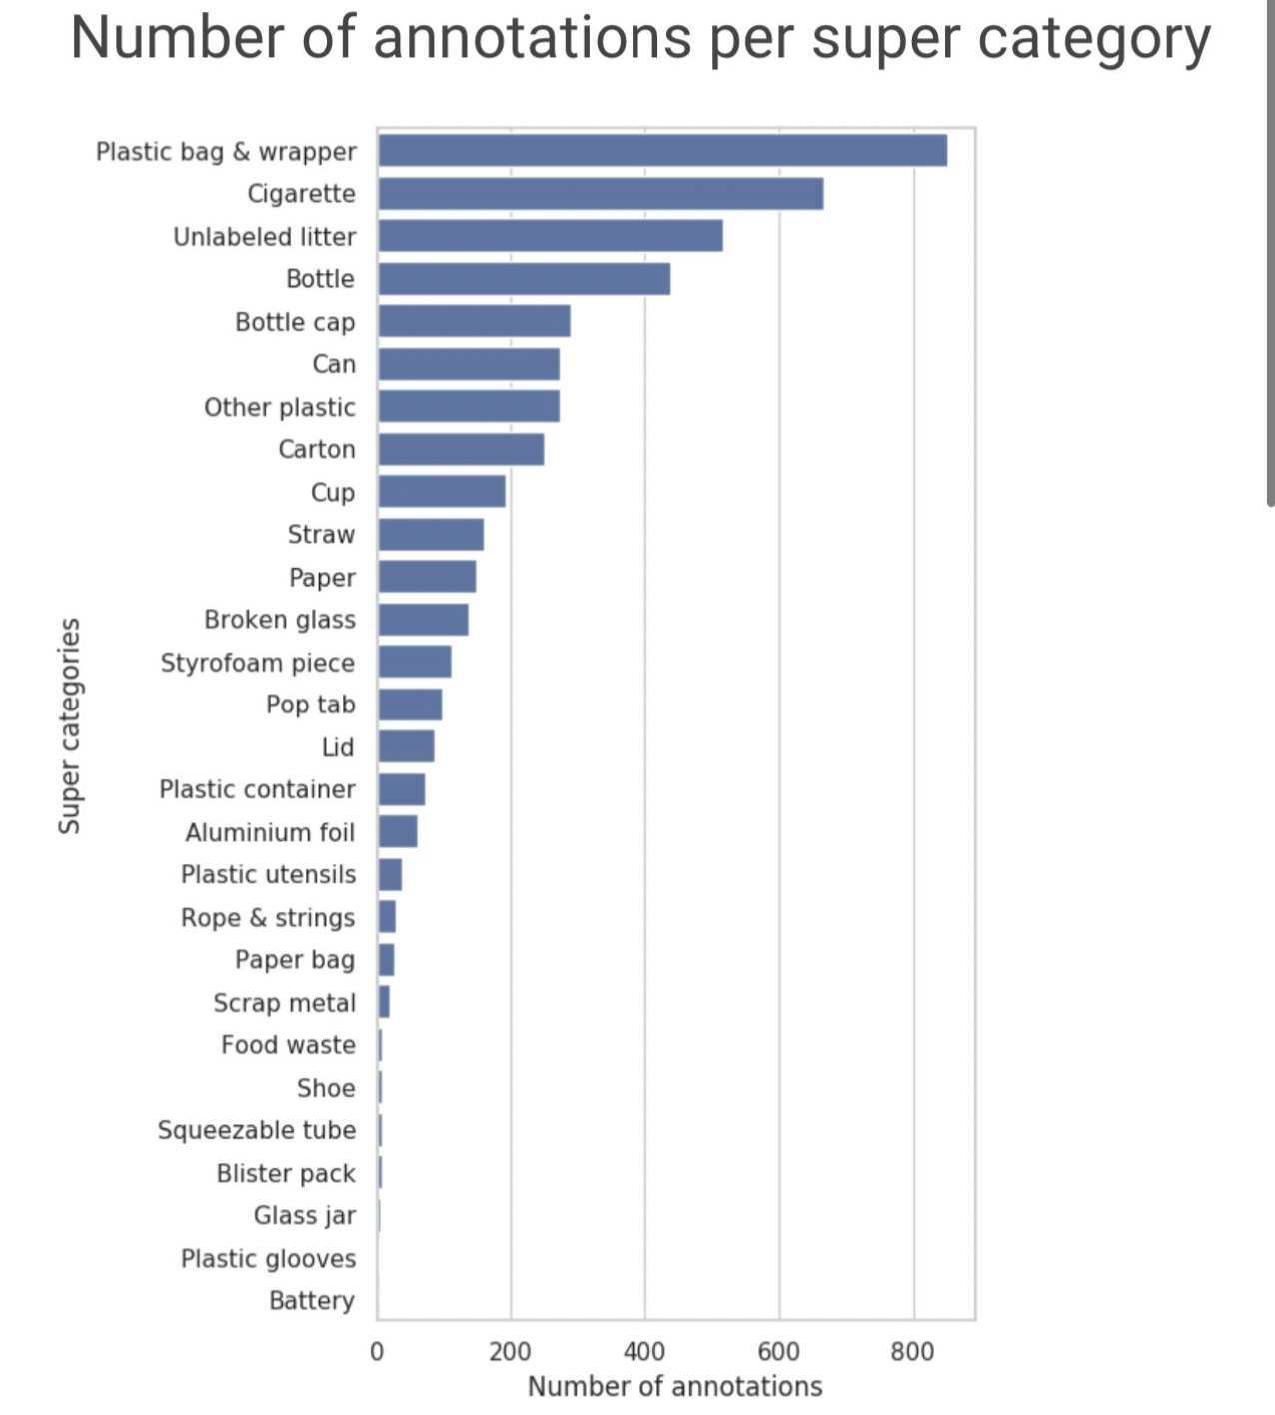
Machine Learning Model: Categories
17
Left graphic shows the current model (V5), categories,
Right graphic shows the previous <V4

Slide 20
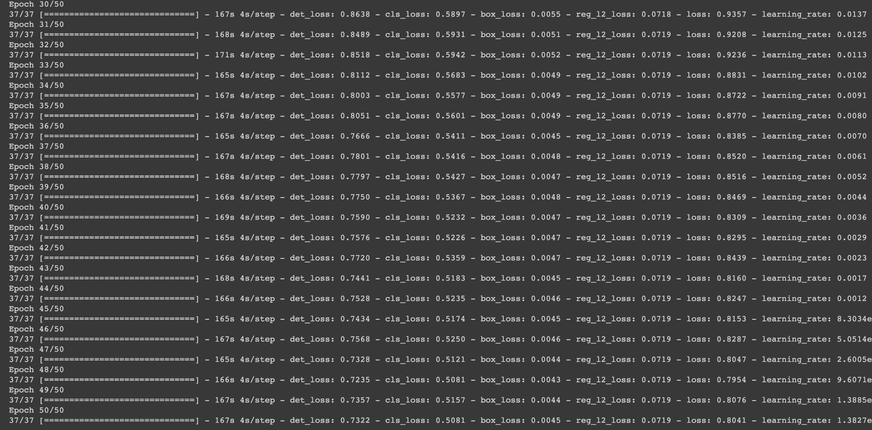
Machine Learning Model: Training
18

Slide 21
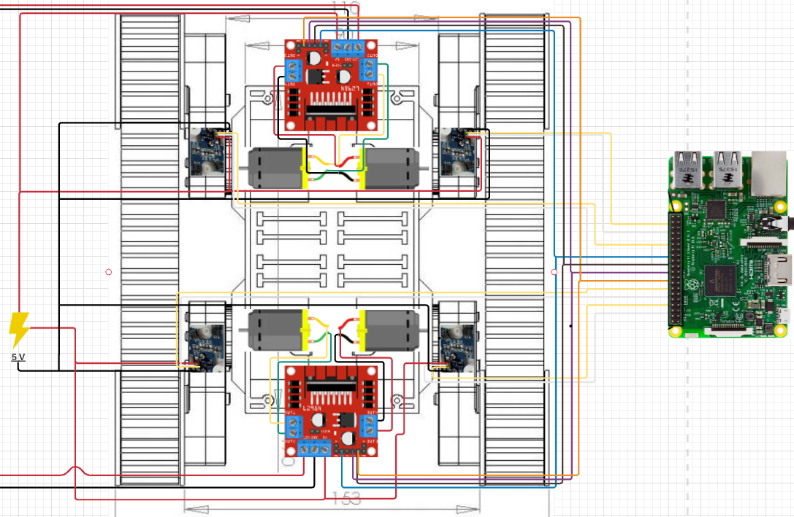
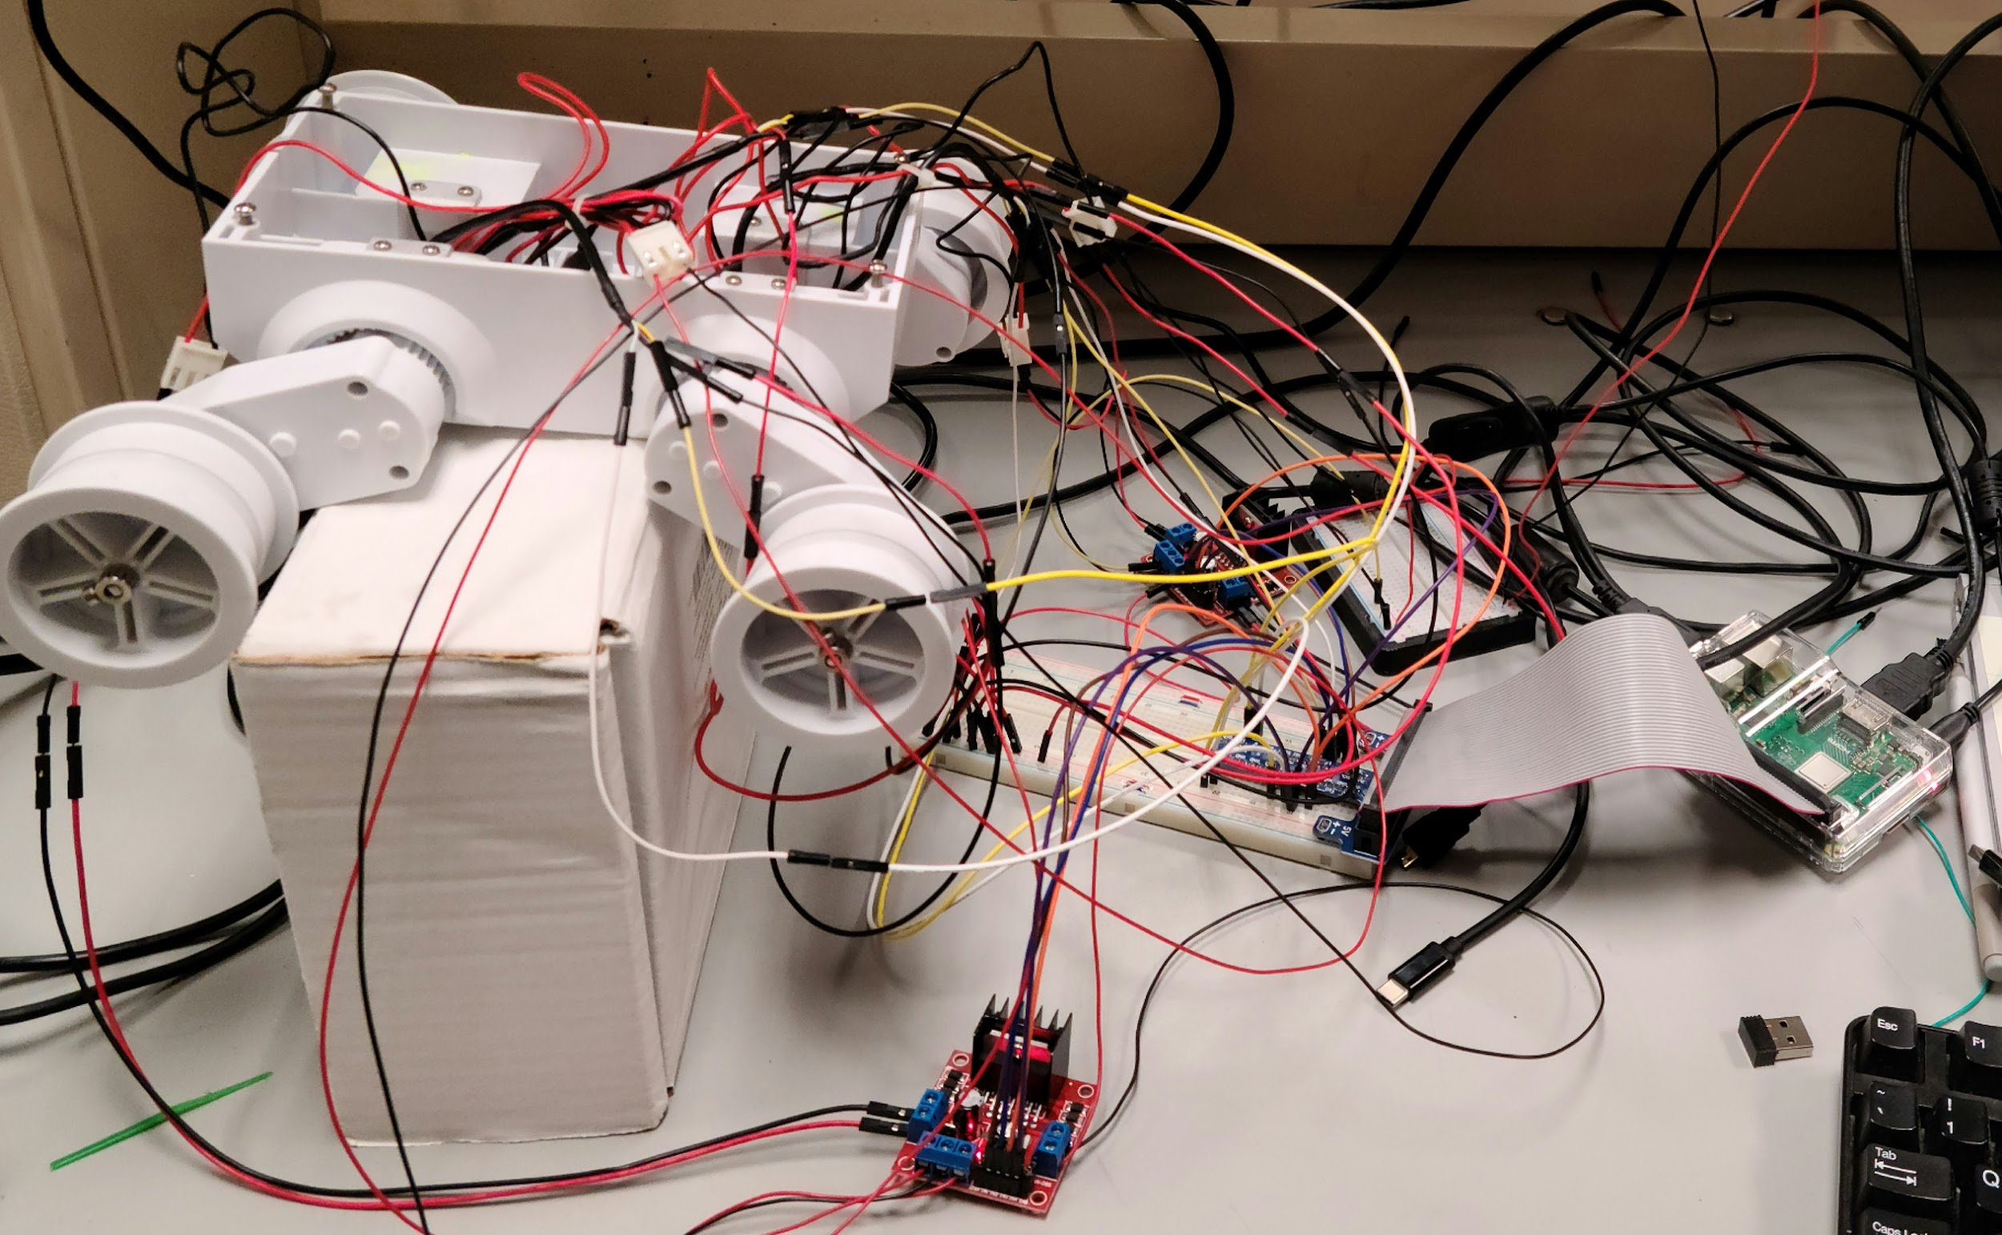
Motor Controller
19
L298N motor drivers receive 5V of power and a supplemental 7V to supply sufficient current and voltage to the motors. Both receive 4 inputs (IN1 - IN4) from Raspberry Pi through 4 GPIO pins, to control clockwise/counterclockwise rotation.
Hall-effect encoders receive 5V of power and output S1 & S2 each to Raspberry Pi through 8 GPIO pins.
Motor controller code functions made in Python in Raspberry Pi manage robot’s movement.

Slide 22
Navigation
20
Rudimentary navigation system for the prototype.
Perceptional navigation based on webcam frames and ultrasonic sensor.
Scans surroundings using webcam and rotating in place, identifies litter, then drives towards it.
Ultrasonic sensor used to properly align sled for collection of litter.

Slide 23
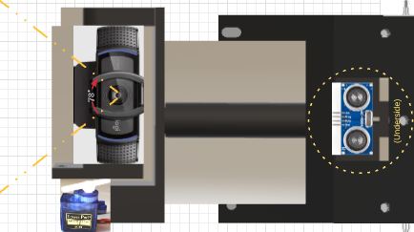
Navigational System Design
21

Slide 24
Prototype Costs
22
Kilogram of Polylactic Acid (PLA): $21.99
SG90 9g servo: $2.60
Webcam: $49.99
Rechargeable Battery x6: $1.44 ea.
Battery Management System (BMS): $4.98
Rover 5 Platform: $59.99
Raspberry Pi 4: $35.00
Google Coral USB Accelerator: $59.99
L298N Motor Driver x4: $10.68
DC Motor: $1.61
Total: $248.27

Slide 25
ABET Criteria
23
Environment
The goal of our robot is to decrease the pollution caused by litter in our natural environments.
Political, Ethical, and Social Issues
Littering is against the law and is the issue that we aim to minimize through our robot.
Sustainability
By implementing a source of renewable energy, such as solar power, our robot may eventually provide its own power consumption.

Slide 26
Planned Improvements
24
Further testing required to implement collection mechanism.
More complex navigational system to increase efficiency of movement.
Use solar panels for a reliable and renewable energy source.
Further improve upon our machine learning model through further training and testing.

